Slide 1
Outland Adventures Database System
Milestone #4 – Final Presentation
Green Group
Group Members: Alexander Baldree
Jordan Dardar
Maksymilian Jankowski
Aftabur Rahman

Slide 2
Group Introduction
We worked as a team to analyze the Outland Adventures case study and design a complete relational database solution. Our goal was to build a system that supports trip scheduling, customer bookings, equipment management, sales/rentals, and reporting; everything needed to help Blythe Timmerson and Jim Ford make better business decisions.

Slide 3

Case Study Overview
Outland Adventures is a growing travel-adventure business that provides guided hiking, camping, and international trekking trips.
Employs guides, marketing, inventory staff, and a web developer
Runs trips in Africa, Asia, and Southern Europe
Let's customers book trips and rent or buy equipment
Wants to optimize operations by analyzing booking trends and inventory age
Needs help answering key business questions:
  Are equipment sales profitable?
  Is any region’s booking demand trending downward?
  Are inventory items older than 5 years?
  Are trip assignments distributed evenly between guides?
  Which equipment items are generating the most order activity (sales + rentals)?
Our database is designed to help answer all these questions.

Slide 4

Design Goals
Our ERD and database were designed around these goals:
Track employees and their roles
Record customers and their bookings
Manage equipment, including age and condition
Record both sales and rentals
Identify regional trends in trip bookings
Support reporting and future expansion
Keep the structure normalized, clean, and scalable

Slide 5
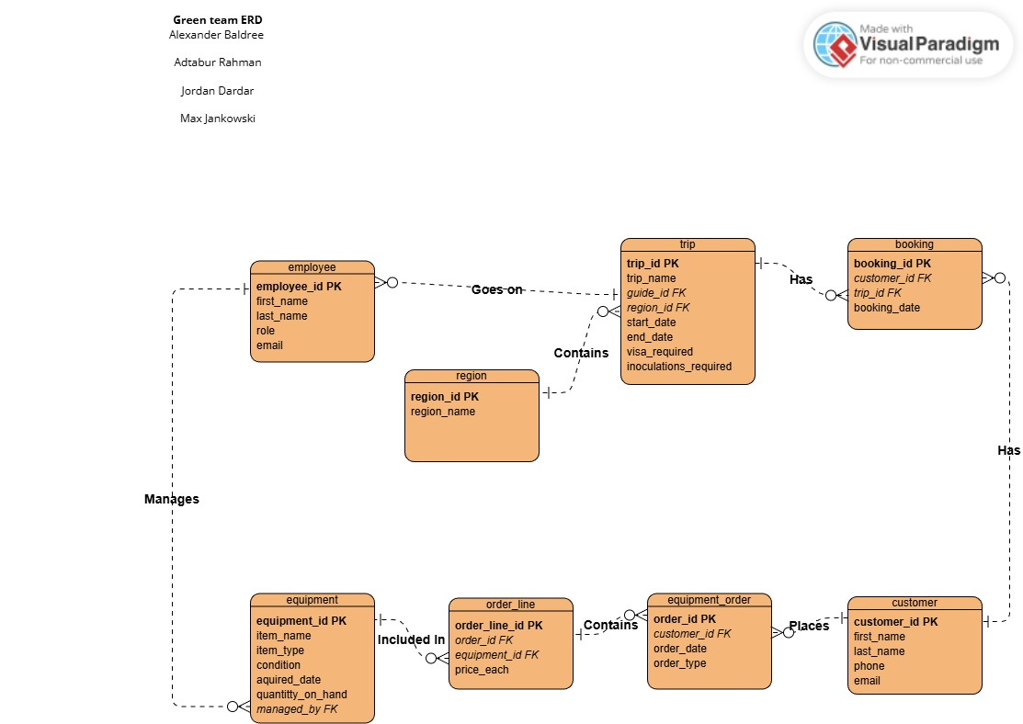
ERD (Entity-Relationship Diagram)
Entities Included:
Employee
Region
Trip
Customer
Booking
Equipment
Equipment_Order
Order_Line
Key Relationships:
Employees guide trips and manage equipment
Customers book trips and place orders
Regions contain multiple trips
Orders contain multiple line items

Slide 6

Assumptions We Made
Each employee has one primary role.
Each trip has one assigned guide.
Equipment can be rented or sold, but not at once.
Inventory age is determined by acquired_date.
A customer can book multiple trips.
Sales and rentals are stored in the same order table, using order_type.
Regions remain fixed (Africa, Asia, Southern Europe), but more can be added.

Slide 7
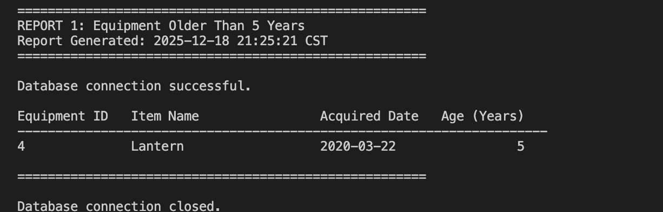
Report 1: Equipment Older Than 5 Years
Purpose: Identify aging inventory to support replacement decisions and reduce safety risks.
Business Question Answered:
Are there inventory items that are over five years old?
Query Result:

Slide 8
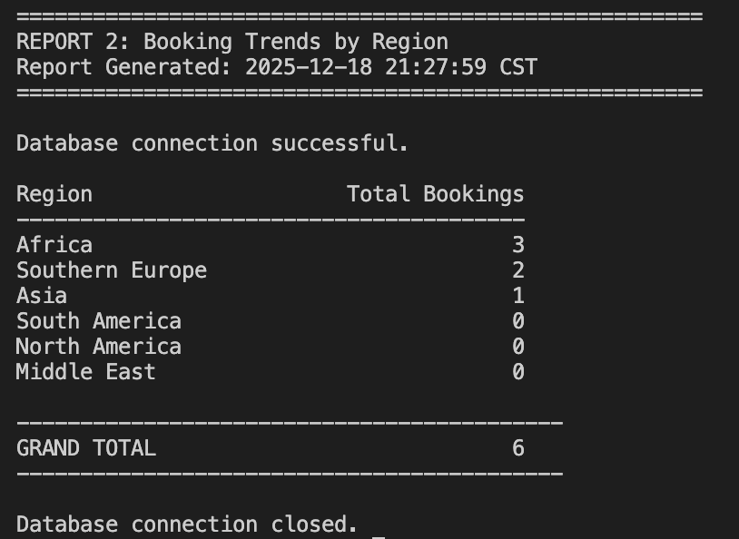
Report 2: Booking Trends by Region
Purpose: Help determine whether Africa, Asia, or Southern Europe is trending downward.
Business Question Answered:
Is any geographic region losing customer interest?
Query Result:

Slide 9
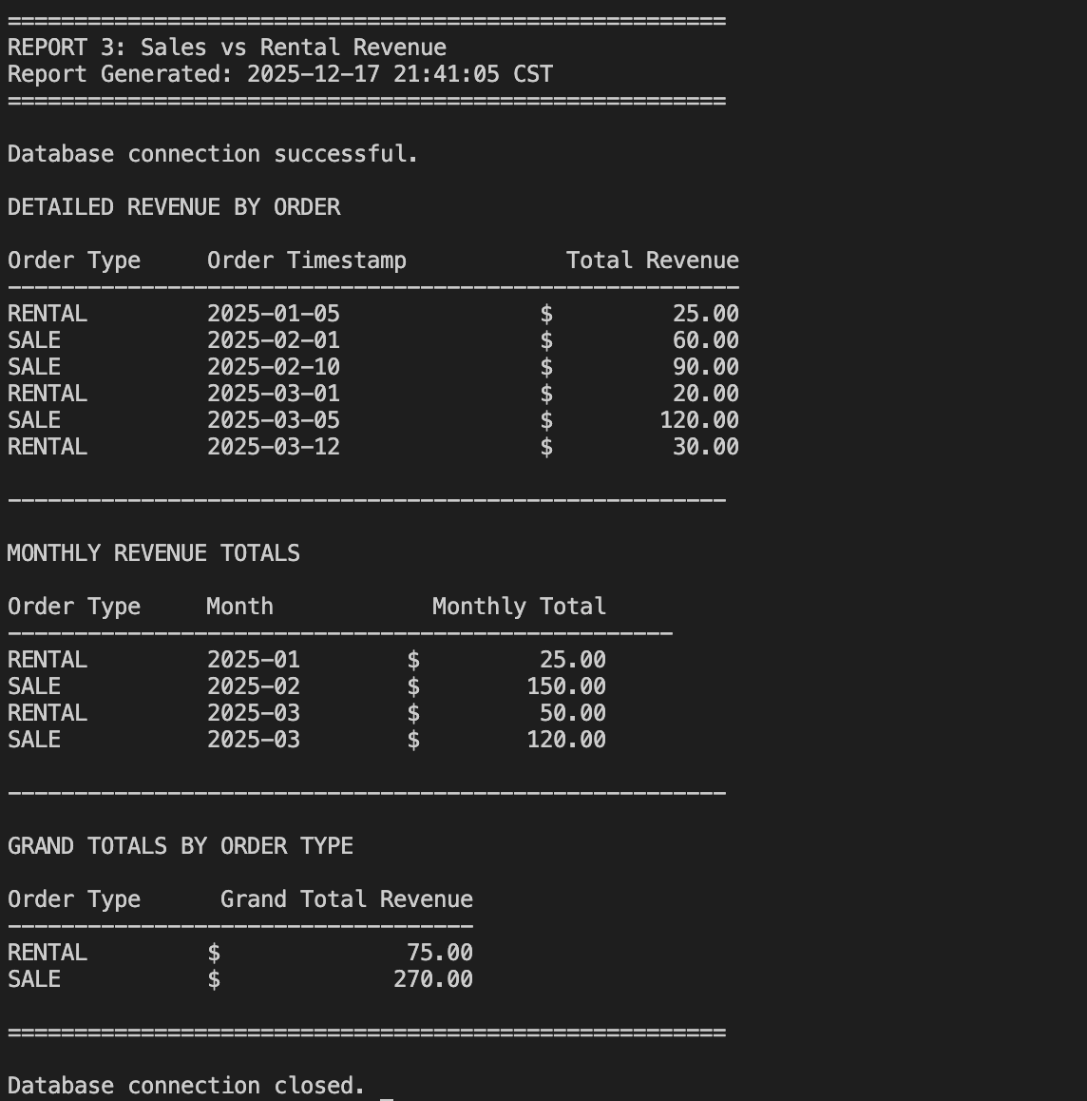
Report 3: Sales vs Rental Revenue
Purpose: Evaluate whether equipment sales are worth keeping in the business model.
Business Question Answered:
Do enough customers buy equipment to justify selling it?
Query Result:

Slide 10
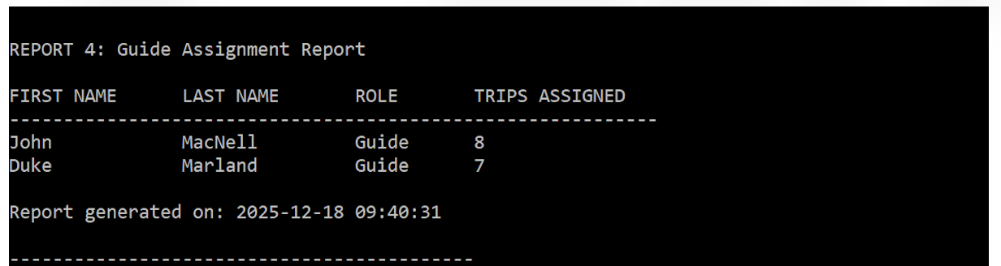
Report 4: Guide Assignment Report
Purpose of the Report
Outland Adventures employs professional guides who lead international treks. Blythe and Jim want to make sure trip assignments are fair and evenly distributed.
Whether workload is balanced
Whether a guide is overloaded
Whether they need to hire additional guides
Business Question Answered
Are trip assignments distributed evenly between guides?

Slide 11
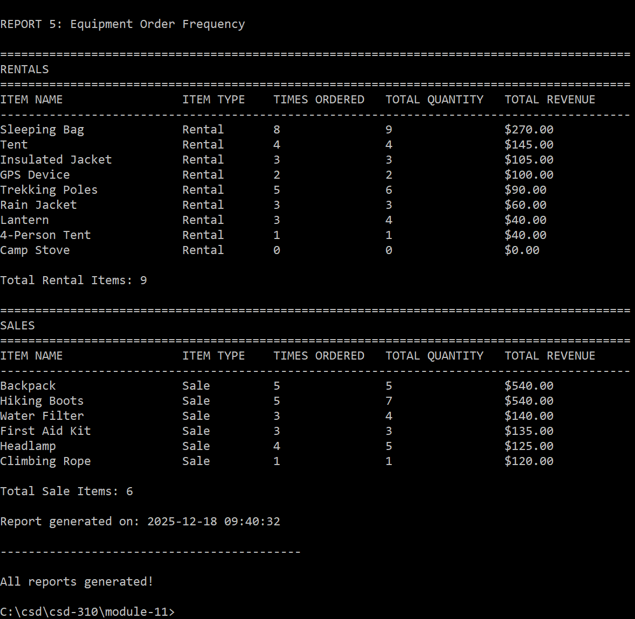
Report 5:
Purpose of the Report
Outland Adventures makes money from both sales and rentals of hiking/camping equipment.
Which items are ordered most often
Whether rentals or sales generate more activity
Which inventory items customers prefer
This helps decide whether to stock more of certain items or discontinue products that rarely move.
Business Question Answered
Which equipment items are generating the most order activity (sales + rentals)?

Slide 12

How These Reports Help the Owners
Our system allows Blythe and Jim to:
Clearly see which regions require more marketing
Replace aging equipment proactively
Compare rental vs sales profitability
Improve customer experience through better planning
Make long-term strategic decisions using real data

Slide 13

Project Summary
Our database solution provides Outland Adventures with:
A complete, normalized data model
Support for bookings, equipment, employees, and orders
Automated reporting for business decisions
Flexibility to expand into ecommerce and more regions
We believe this system gives the business exactly what it needs to grow efficiently.

Slide 14

Thank You
Questions?
Green Group
Alexander Baldree
Jordan Dardar
Maksymilian Jankowski
Aftabur Rahman

